Slide 1
Background

Slide 2
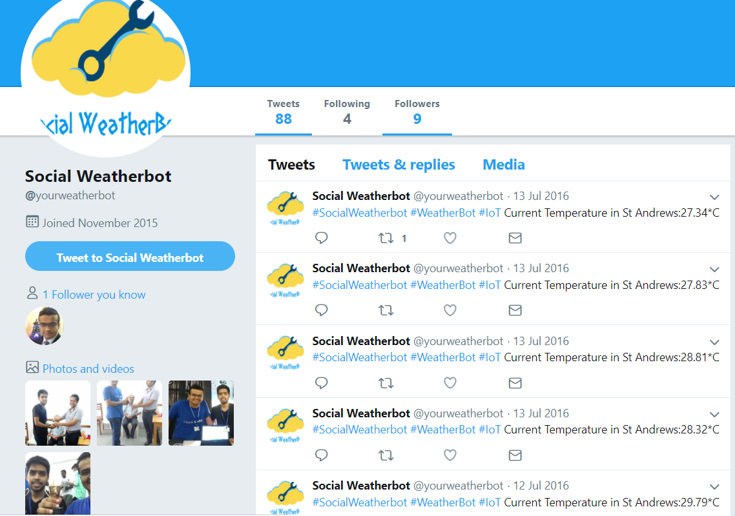
Bachelors
Bachelor Of Science in Information Technology from Mumbai University.
Project:
Disaster Management Radio Transmitter
Social WeatherBot
Socialize

Slide 3
Masters
Symbiosis Institute Of Computer Studies And Research
Master Of Science in Computer Application (Software Development)
Projects
BitCoin Data Viewer
R Sports Analyzer
Automatic Ambulance Service
Software Engineering for Cyber Physical Systems with Gov of India.

Slide 4
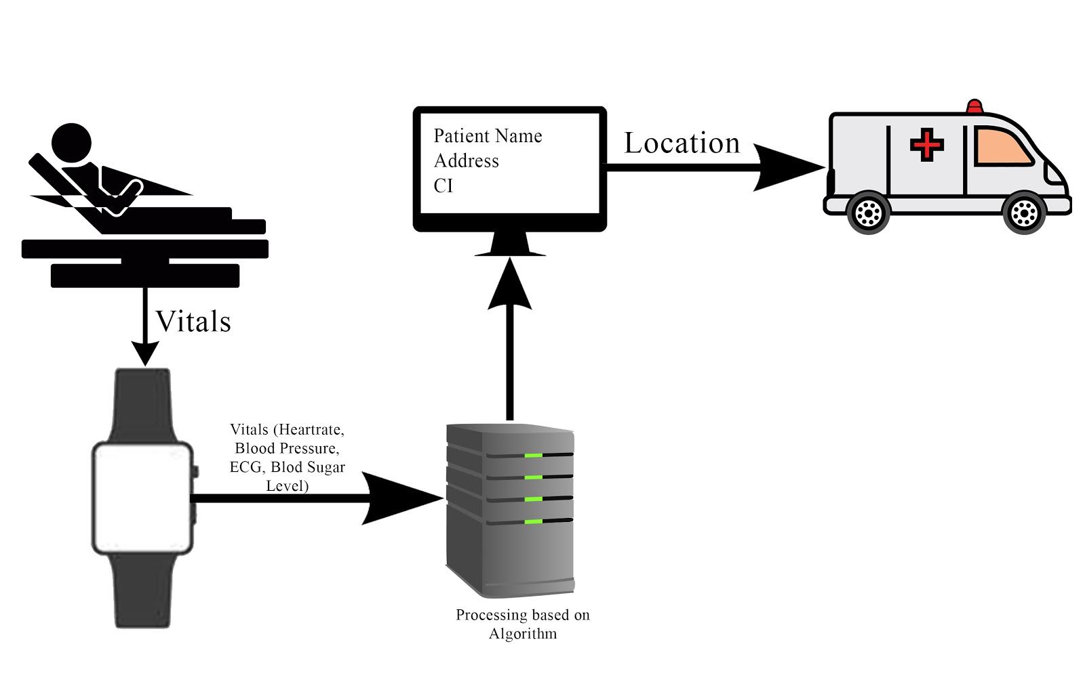

Slide 5
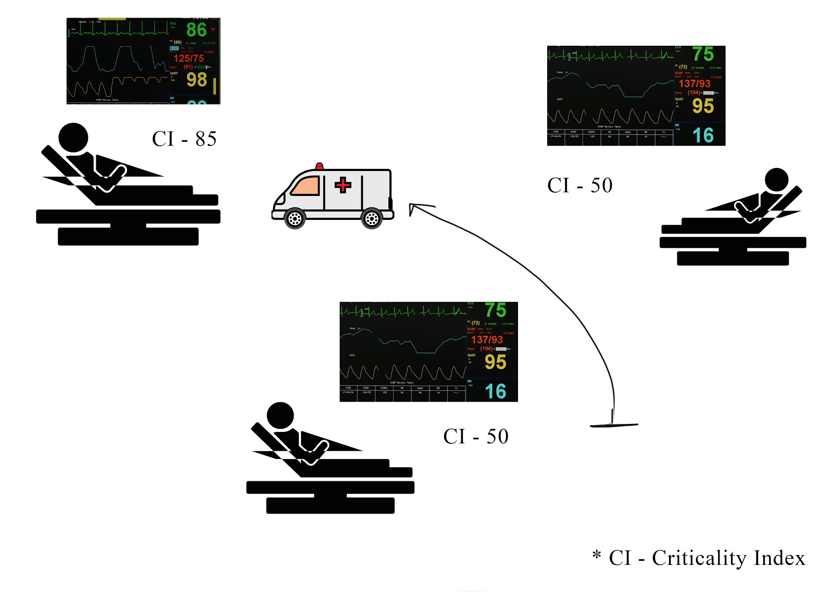

Slide 6

Freelancer
SoBo House Of Music
www.sobohouseofmusic.com
Payment Gateway
Billing System
Social Media Management

Slide 7

Freelancer
Ixora Vineyars
www.ixoravineyards.com
Social Media Management

Slide 8

Freelancer
Allspark Inc
www.allsparkinc.com
Payment Gateway
Billing System
Social Media Management

Slide 9

Freelancer
Living Word Church
www.livingword.in
SEO
Android Application
Social Media Management

Slide 10
Network Coding

Slide 11
What is network coding?
Network coding is a method of optimizing the flow of digital data in a network by transmitting digital evidence about messages. The "digital evidence" is, itself, a composite of two or more messages.
Network coding is a networking technique in which transmitted data is encoded and decoded to increase network throughput, reduce delays and make the network more robust.

Slide 12
Estimations and Figures
By 2020 75% of Network Traffic will be video stream
By 2020, 7 trillion video clips are expected to be uploaded
Mobile video is expected to increase, representing more than 75% of the world's mobile data traffic.
Services will Start Using the network even more
Health
Finance
Education

Slide 13
Why network coding?

Slide 14
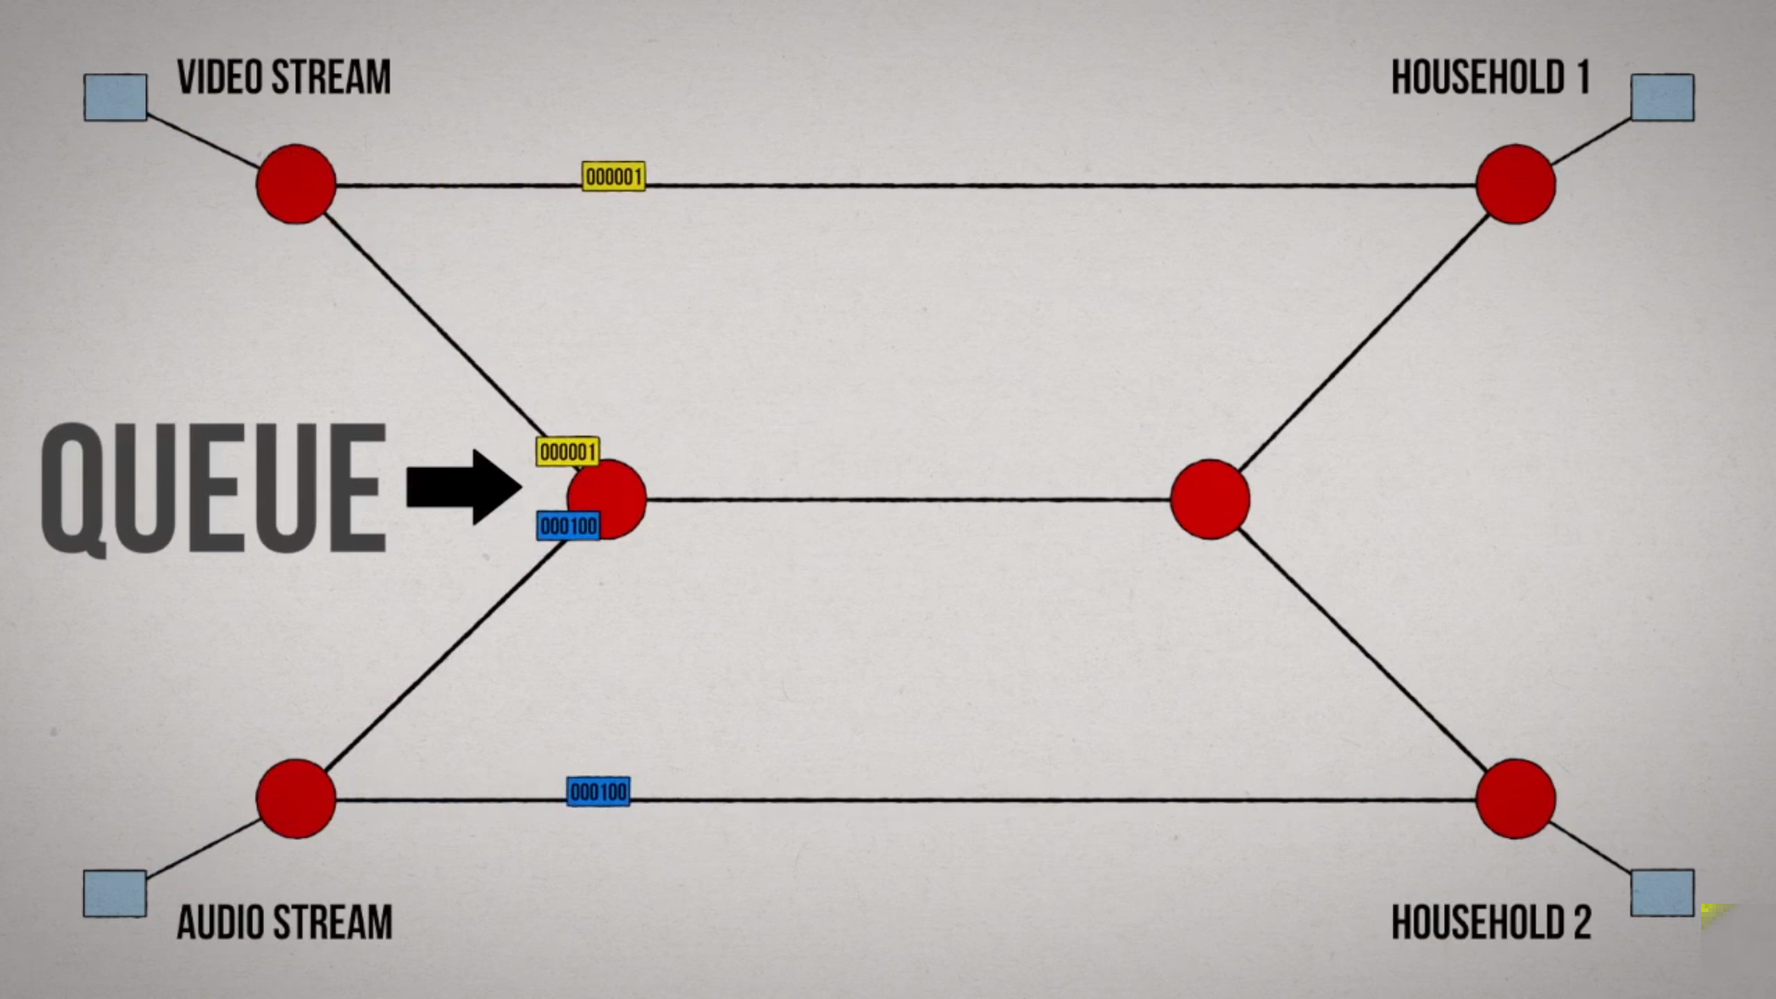

Slide 15
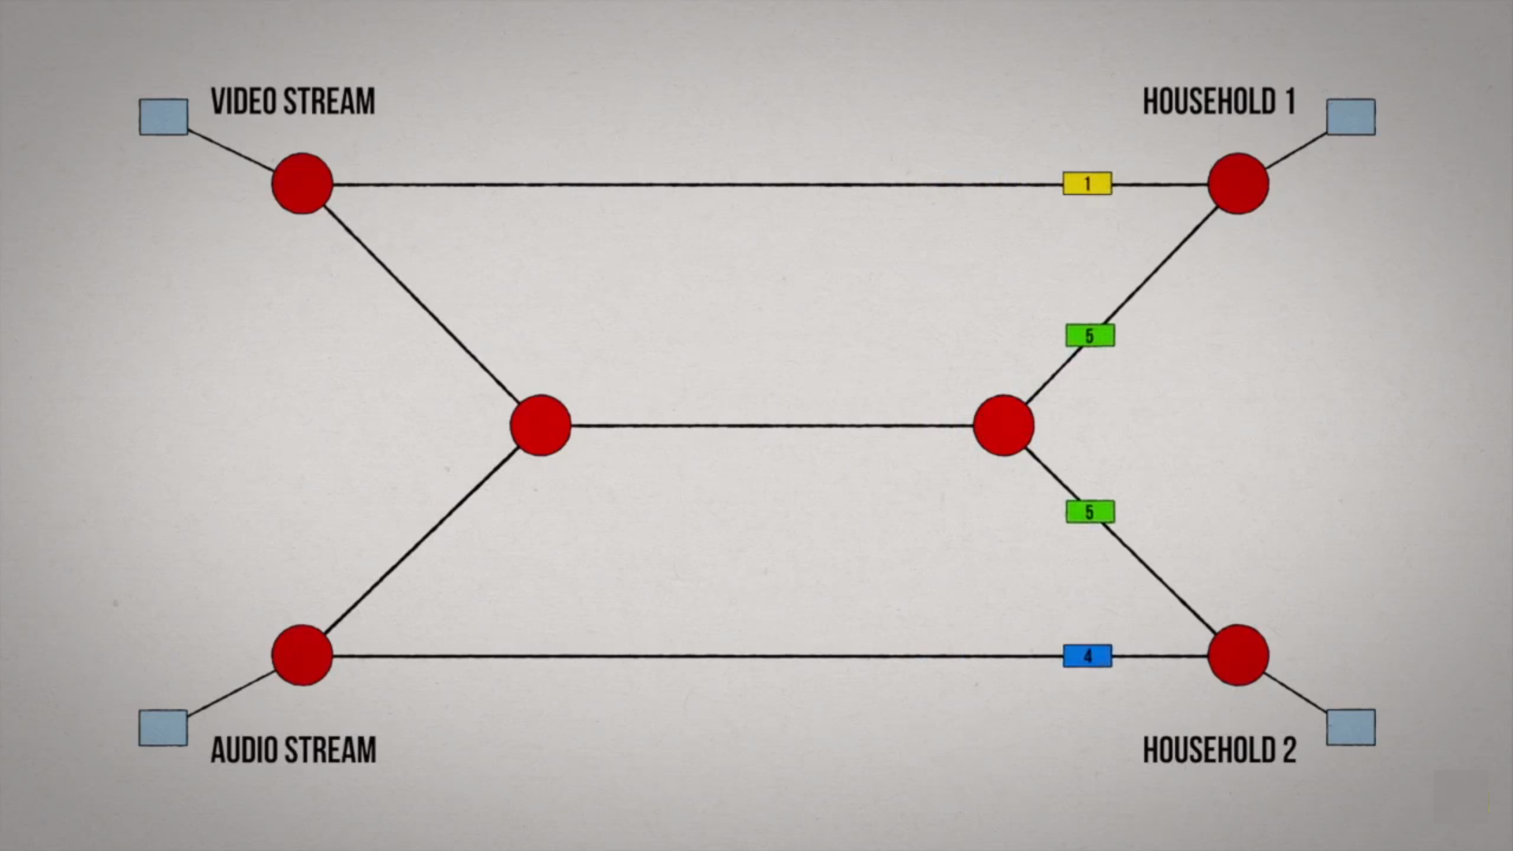

Slide 16
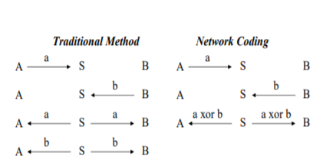

Slide 17
Network Coding
To do a comparative study of how network coding can improve our current networks.
To foresee the challenges when implementing network coding.
What Could be the applications where network coding can be introduced to drastically improve the network
Security while implementing network coding

Slide 18
Wireless networks
Security
Distributed Computing
Storage
Applications
Advantages
Challenges

Slide 19
Thank You

